Slide 1
Cis-476 term project
By: Mohamed Muhsin , Yeha altamimi , Deniz

Slide 2
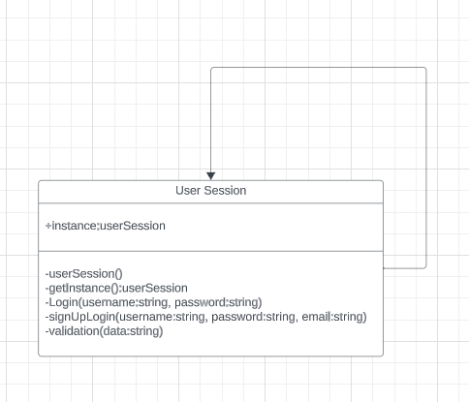
Login singleton session

Slide 3
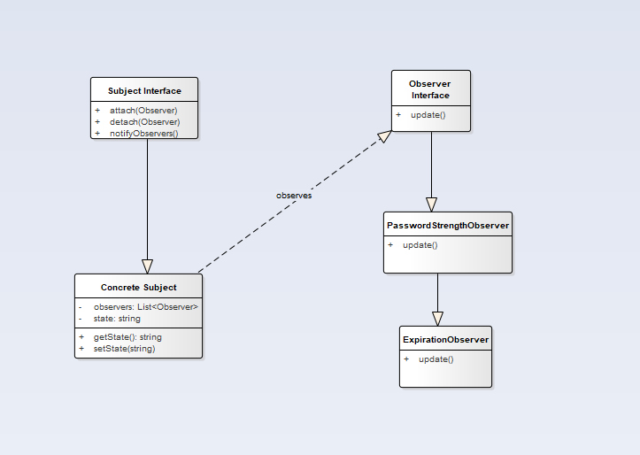
Password management

Slide 4
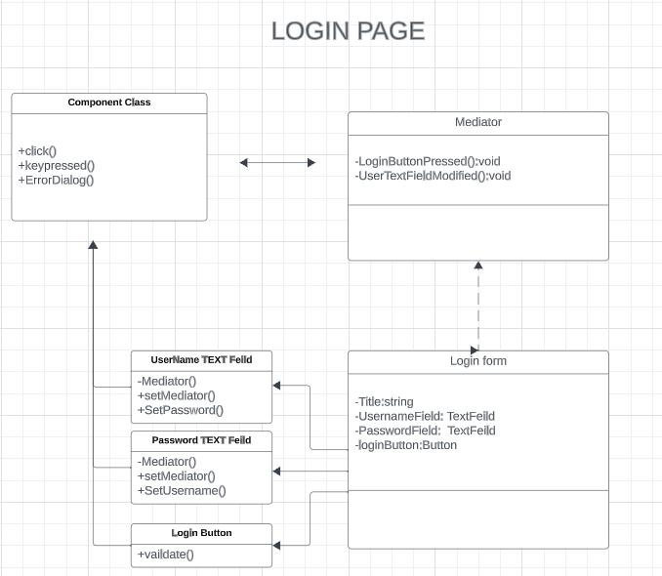
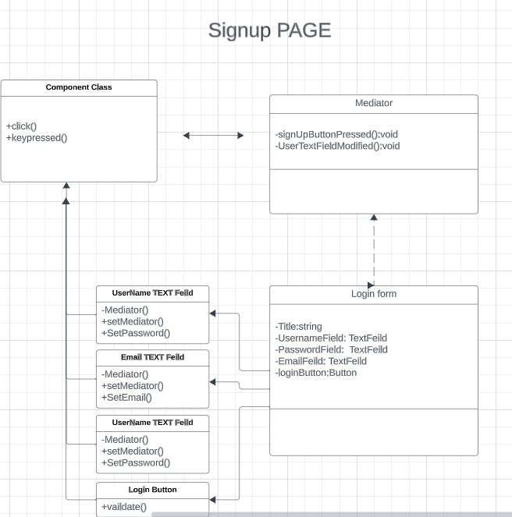
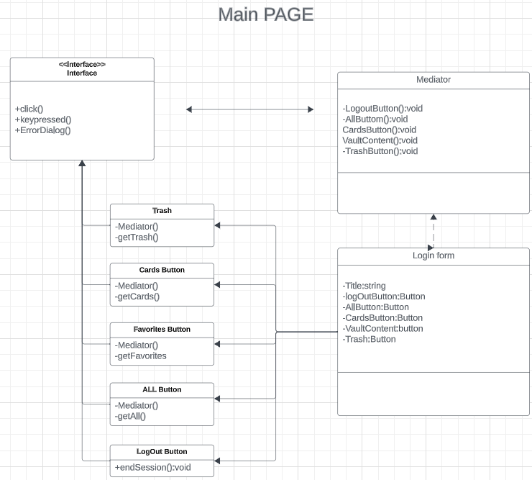
User InterFace and Interactions

Slide 5
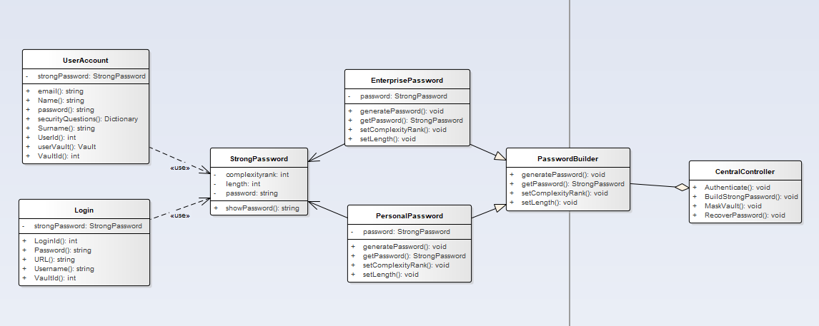
Password Generation

Slide 6
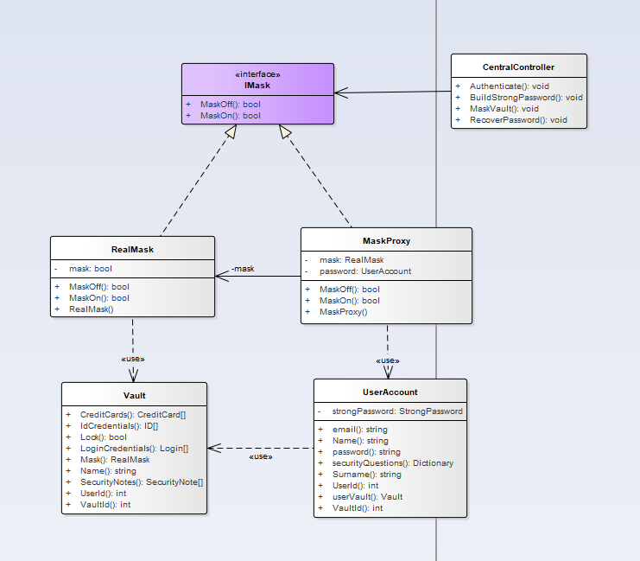
Data Mask and Unmask

Slide 7
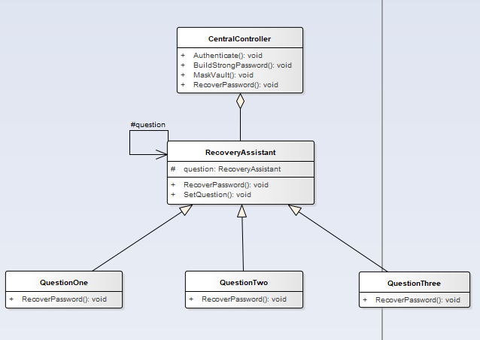
Master Password Recovery

Slide 8
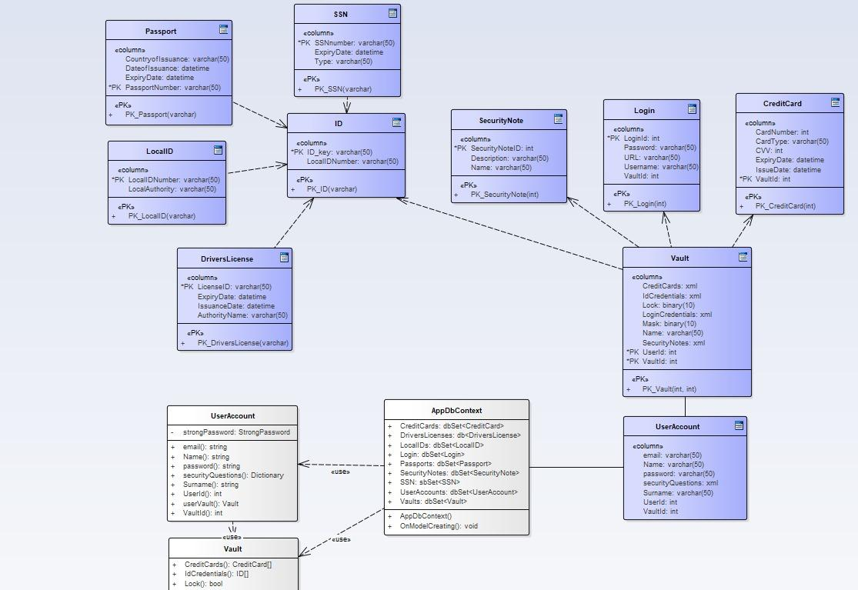
DataBase ER Diagram

Slide 9
